Slide 1
FitSM Foundation
Foundation training in IT Service Management according to FitSM
Version 3.0.5

Slide 2
Purpose of this training
Become familiar with
Basic IT service management concepts and terms
Purpose and structure of FitSM standards and their relationship to other standards
FitSM approach and key principles
Process framework underlying FitSM
Selected requirements defined in FitSM-1
Achieve the Foundation Certificate in IT Service Management according to FitSM

Slide 3
FitSM Foundation exam
At the end of this training
Closed-book exam, i.e. no aids are allowed
Duration: 30 minutes
20 multiple choice questions:
Four possible answers for each question: A, B, C or D
One correct answer per question
At least 65% correct answers (13 of 20) are required to pass the examination

Slide 4
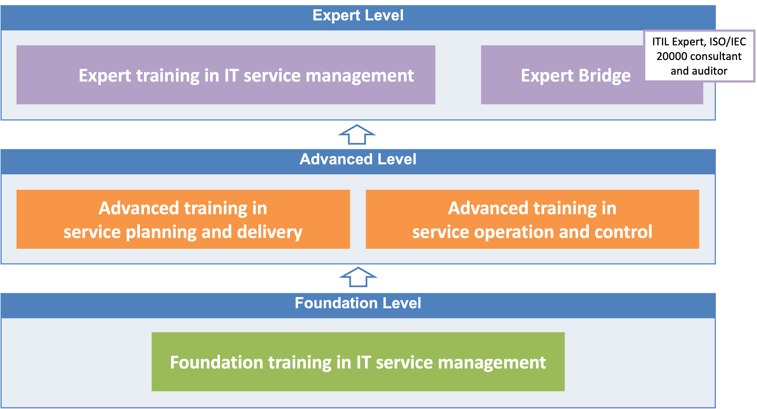
FitSM qualification program
Notes:
Full training titles:
Expert training in IT service management according to FitSM (typically 2-3 days)
Advanced training in service planning and delivery according to FitSM (typically 2 days)
Advanced training in service operation and control according to FitSM (typically 2 days)
Foundation training in IT service management according to FitSM (typically 1 day)

Slide 5
Training agenda
IT Service Management: Introduction, Terms & Concepts
The FitSM Approach & Standards Family
IT Service Management – General Aspects
IT Service Management – Processes
Benefits, Risks & Challenges of Implementing IT Service Management
Related Standards & Frameworks

Slide 6
IT Service Management: Introduction, Terms & Concepts

Slide 7
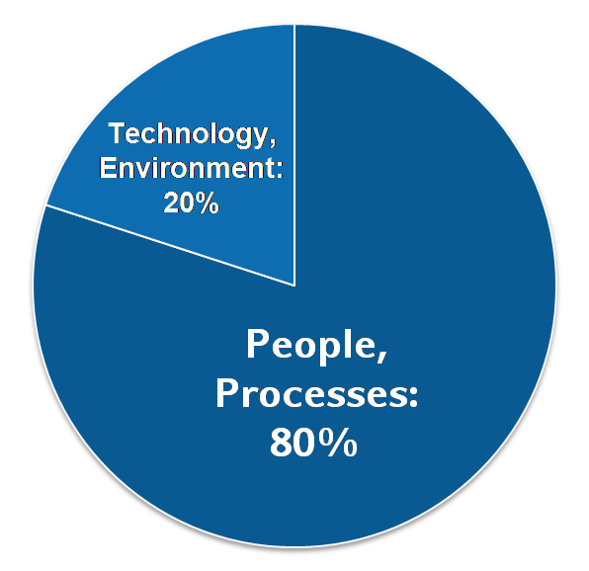
Why IT service management is needed
Why IT service management (ITSM)?
Most IT outages stem from "people and process issues."
Outage durations depend largely on non-technical factors.
IT service management …
…aims to provide high quality IT services that meet customer and user expectations,
…and achieves this through the definition, establishment, and maintenance of service management processes.
Reasons for service outages

Slide 8
Service and value
A service is…
... an intangible good delivered by a service provider to customers
… something that provides value to the customers by helping them achieve their goals
... is typically provided as a stand-alone deliverable
Function
Quality
Value
What does the service do?
How (e.g. regarding reliability, performance etc.) does a service need to delivered in order to help the customers achieve their goals?
Notes:
The distinction between service function and service quality in IT Service Management is similar to the distinction made in the field of Requirements Engineering between functional requirements and non-functional requirements (often called quality attributes)
FND Syllabus: A.1

Slide 9
What is a service?
Definition following FitSM-0:
Service: A way to provide value to a user / customer through bringing about results that they want to achieve
Examples of IT services:
Provision of standard desktop workstations
Connectivity: E-Mail, LAN, internet access
Provision of computational resources
Provision of standard and special applications
Storage, backup, archival storage
Definition following FitSM-0:
Service provider: Organisation or federation (or part of an organisation or federation) that manages and delivers a service or services to customers
Notes:
FND Syllabus: A.1

Slide 10
What is a process?
Key facts about ITSM processes:
ITSM processes support and control the delivery of IT services.
ITSM processes interact with each other, and with other processes in the service provider organization
Successful provisioning of IT service involves several processes..
The ITSM processes of an IT service provider are part of the service management system (SMS).
Definition following FitSM-0:
Process: Structured set of activities, with clearly defined responsibilities, that bring about a specific objective or set of results from a set of defined inputs
Notes:
FND Syllabus: A.3

Slide 11
Organisational structure vs. process
Top management
1
Service desk
Client operations
Server operations
Communication networks
5
2
Mobile devices
DB servers
Web servers
Application servers
Network planning
Desktop support
ERP
3
Network maintenance
4
CRM
Notes:
Discussion: Imagine the handling of an incident that is reported to the service desk. Who is responsible for the overall outcome? The service desk says it is a DB issue. The DB server team say it is a network issue. The Network team says it is a Desktop support issue, who refer it back to the helpdesk.
Without ITSM roles and responsibilities: who is responsible for the resolution of the incident? Perhaps Top Management, but does that help the user get their service running again?
FND Syllabus: A.3

Slide 12
Most important elements of a process
Goal(s), objectives
Clearly defined inputs, triggers and outputs
Set of interrelated activities (across different functions)
Roles and responsibilities
Measurements and KPIs
Notes:
FND Syllabus: A.3

Slide 13
Service management system (SMS): Overview
Policy
1. Abc def ghijk.
2. Abc def ghijk.
3. Abc def ghijk.
4. Abc def ghijk.
Governance level
Top management
Process owners
e.g. service management policy, incident handling policy
Process level
Process managers
Process:
Inputs
Activities and roles
e.g. incident and service request management
Outputs
Operational level
Process staff
Procedures
Person (in a role)
e.g. procedures for classifying and prioritizing incidents
Notes:
FND Syllabus: A.2, A.3

Slide 14
Service management system (SMS): Key terms
Definition following FitSM-0:
Service management system (SMS): Overall management system that controls and supports management of services within an organisation or federation
Definition following FitSM-0:
Policy: Documented set of intentions, expectations, goals, rules and requirements, often formally expressed by top management representatives in an organisation or federation
Definition following FitSM-0:
Activity: Set of actions carried out within a process
Definition following FitSM-0:
Procedure: Specified set of steps or instructions to be carried out by an individual or group to perform one or more activities of a process
Notes:
FND Syllabus: A.2, A.3

Slide 15
Service management system (SMS): Key roles
Service owner:
Overall responsibility for a service
Maintains the service definition (in the service portfolio)
Is the primary contact point and expert for this service
Process owner:
Overall accountability for a process
Defines process goals, monitors their fulfillment
Has authority to provide / approve resources
Process manager:
Responsible for the operational effectiveness and efficiency of a process
Reports to the process owner
Process staff:
Responsible for performing a specific process activity
Escalates exceptions to the process manager
Notes:
FND Syllabus: A.3

Slide 16
Service management system (SMS): Key roles
Overall service management system (SMS)
Process owner:
Processes 1 & 2
Process owner:
Process 3
Process Manager
Process Manager
Process Manager
Process 1
Process 2
Process 3
Service owner: Service 1
Service 1
Activity 1
Activity 1
Activity 1
Process Staff
Process Staff
Process Staff
Service owner: Service 2
Activity 2
Activity 2
Activity 2
Service 2
Activity 3
Activity 3
Activity 3
Notes:
FND Syllabus: A.3

Slide 17
The FitSM Approach & Standards Family

Slide 18
What is FitSM?
A family of standards for lightweight IT service management
Suitable for IT service providers of any type and scale
Main design principle: Keep it simple!
All parts (and this training material) freely available under Creative Commons licenses:
www.fitsm.eu
The development of the FitSM standards was supported and funded by the European Commission through the EC-FP7 project “FedSM”.
Notes:
FND Syllabus: E.1

Slide 19
The FitSM approach
The key principles of the FitSM approach to managing IT services:
Practicality
The foundation for systematic IT Service Management:
Consistency
Service- and customer-orientation
Process-orientation
Continual improvement
Sufficiency
Extendibility
Notes:
FND Syllabus: E.1

Slide 20
ITSM principles
Principle | Explanation
Service- and customer-orientation | IT-driven solutions provided to customers and users are arranged as services and provided according to clearly defined service levels. Services are aligned to the needs and expectations of (potential) customers. Both the service provider and customer are aware of agreed service targets.
Process-orientation | Activities required to plan, deliver, operate and control services are carried out as part of well-understood and effective processes.
Continual improvement | The entire service management system follows the plan-do-check-act approach. All processes and activities necessary to manage IT services as well as the services themselves are subject to evaluation, aimed at identifying opportunities for improvement and taking appropriate follow-up actions.
Notes:
FND Syllabus: E.1

Slide 21
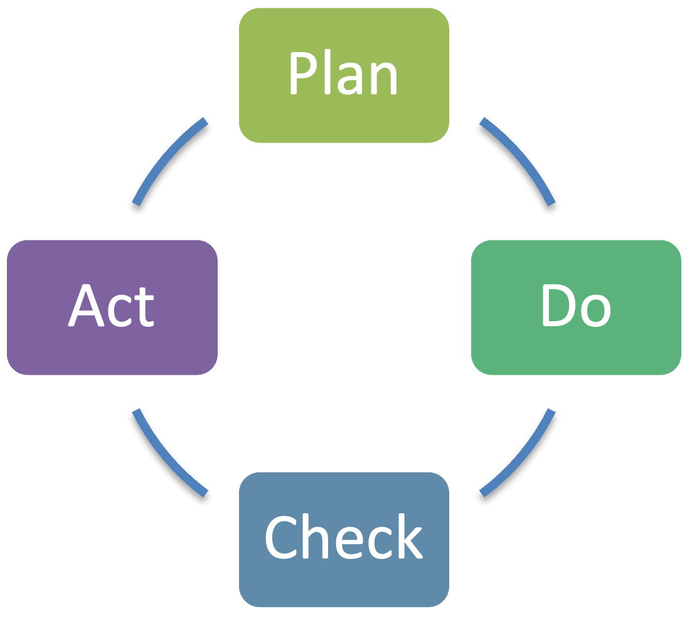
ITSM principles: Plan-Do-Check-Act cycle (PDCA)
Maturity
Time
Quality management approach according to W. E. Deming
Key principle: continual improvement
Plan-Do-Check-Act can be applied to the whole service management system
Notes:
FND Syllabus: A.5

Slide 22
FitSM key principles
Principle | Explanation
Practicality | Apply simple, proven guidance instead of drowning in theoretical best practices
Consistency | Repeatable performance before detailed documentation
Sufficiency | Good enough and working over seeking the perfect solution
Extendibility | Leverage many sources of knowledge rather than live in a walled garden
Notes:
FND Syllabus: E.1

Slide 23
FitSM parts
Core standard
FitSM-0
Overview & vocabulary
Focus of this training
FitSM-1
Requirements
FitSM-2
Process activities and implementation
FitSM-3
Role model
Implementation aids
FitSM-4
Templates and samples
FitSM-5
Implementation guides
FitSM-6
Maturity and capability assessment scheme
Notes:
FND Syllabus: E.1

Slide 24
FitSM process model
Service Portfolio Management (SPM)
Service Level Management (SLM)
Service Reporting (SRM)
Service Availability and Continuity Management (SACM)
Capacity Management (CAPM)
Information Security Management (ISM)
Customer Relationship Management (CRM)
Supplier Relationship Management (SUPPM)
Incident and Service Request Management (ISRM)
Problem Management (PM)
Configuration Management (CONFM)
Change Management (CHM)
Release and Deployment Management (RDM)
Continual Service Improvement Management (CSI)
Notes:
FND Syllabus: E.1

Slide 25
A possible grouping of the FitSM processes
Two main topic areas:
Plan & Deliver
SPM
SLM
SRM
CRM
SUPPM
SACM
CAPM
ISM
Operate & Control
CONFM
CHM
RDM
ISRM
PM
CSI

Slide 26
FitSM-0: "Overview & vocabulary"
FitSM-0 defines 80 important terms from the IT service management context:
Activity
Assessment
Audit
Availability
Availability of information
Capability level
Capacity
Change
Classification
Closure
Competence
Confidentiality of information
Conformity
Configuration
Configuration item (CI)
Configuration management database (CMDB)
Continuity
Customer
Demand
Document
Effectiveness
Efficiency
Emergency change
Escalation
Federation
Federation member
Federator
Improvement
Incident
Information security
Information security control
Information security event
Information security incident
Integrity of information
IT service
IT service management (ITSM)
Key performance indicator (KPI)
Known error
Major change
Major incident
Management review
Management system
Maturity level
Nonconformity
Operational level agreement (OLA)
Operational target
Policy
Post implementation review (PIR)
Priority
Problem
Procedure
Process
Record
Release
Release and deployment strategy
Report
Request for change
Risk
Role
Service
Service acceptance criteria (SAC)
Service catalogue
Service component
Service level agreement (SLA)
Service lifecycle
Service management
Service management plan
Service management system (SMS)
Service portfolio
Service provider
Service request
Service review
Service target
Supplier
Top management
Underpinning agreement (UA)
Underpinning contract (UC)
User
Value
Workaround

Slide 27
FitSM-1: "Requirements"
FitSM-1 defines 82 requirements that should be fulfilled by an organisation (or federation) offering IT services to customers.
Compliance with the 82 requirements can be regarded as a "proof of effectiveness".
The 82 requirements are structured as follows:
17 general requirements (GR)
65 process-specific requirements (PR)
Consideration of the 14 IT service management processes from the FitSM process model
Between 3 and 6 requirements per process

Slide 28
IT Service Management – General Aspects

Slide 29
General aspects: Overview
General aspects of a service management system (SMS) cover all topics that are not directly related to a specific ITSM process.
Topics to be considered:
Top Management Commitment & Accountability (MCA)
Documentation (DOC)
Scope & Stakeholders of IT Service Management (SCS)
Planning IT Service Management (PLAN)
Implementing IT Service Management (DO)
Monitoring & Reviewing IT Service Management (CHECK)
Continually Improving IT Service Management (ACT)

Slide 30
ITSM – General aspects: Top management
GR1 MCA
Top management commitment & accountability:
Assigning one individual to be accountable for the overall SMS
Defining and communicating goals
Defining a general service management policy
Conducting management reviews
Documentation:
Documentation to support effective planning, including:
General service management policy
Service management plan and related plans (see GR4)
Definitions of all service management processes (see PR1-PR14)
Document control, addressing (as applicable):
Creation and approval
Communication and distribution
Review
Versioning and change tracking
GR2 DOC
Notes:
FND Syllabus: A.4

Slide 31
PDCA applied to the SMS: Key concepts
GR3 SCS GR4 PLAN
Planning IT service management:
Scope of the SMS
Timetable for implementing service management processes (service management plan)
Implementing IT service management:
Putting the plan into practice
Supporting and enforcing practical implemtation of defined processes
Monitoring & reviewing IT service management:
Monitoring key performance indicators (KPIs) to evaluate effectiveness and efficiency
Performing assessments and / or (internal) audits to determine the level of conformity
Assessing the organisational maturity
Continually improving IT service management:
Addressing nonconformities and deviations from goals
Take action -> Manage improvements through the CSI process (see PR14)
GR5 DO
GR6 CHECK
GR7 ACT
Notes:
FND Syllabus: A.5

Slide 32
General aspects: Summary
Most important things to remember:
Management buy-in is vital to the success of IT service management
Serious buy-in = mandate, resources, communication!
A certain level of documentation is necessary for effective processes
Only write documents that someone is going to read!
Embed the principles of continual improvement in the SMS, leveraging the PDCA approach
Notes:
FND Syllabus: A.4, A.5

Slide 33
IT Service Management – Processes

Slide 34
Service Portfolio Management (SPM)
Objective
To maintain the service portfolio and to manage services through their lifecycle
Notes:
FND Syllabus: B.1

Slide 35
What is a service?
Definition following FitSM-0:
Service: A way to provide value to a user / customer through bringing about results that they want to achieve
Definition following FitSM-0:
Service component: Logical part of a service that provides a function enabling or enhancing a service Note 1: A service is usually composed of several service components. Note 2: A service component is usually built from one or more configuration items (CIs).
Services
Service 1
Service 2
Service components
SC 1
SC 2
SC 3
SC 4
SC 5
Notes:
FND Syllabus: A.1

Slide 36
SPM: Important terms
Definition following FitSM-0:
Service portfolio: Internal list that details all the services offered by a service provider, including those in preparation, live and discontinued
Definition following FitSM-0:
Service lifecycle: The series of phases a service may move through in its lifetime Note 1: Specific service lifecycle phases are typically defined for each organisation, depending on the complexity needed. These may include initial idea, proposal, design, development, deployment, production and retirement.
Notes:
FND Syllabus: B.1

Slide 37
SPM: Requirements according to FitSM-1
PR1 Service Portfolio Management (SPM)
REQUIREMENTS
PR1.1 A service portfolio shall be maintained. All services shall be specified as part of the service portfolio. PR1.2 Proposals for new or changed services shall be evaluated based on predicted demand, required resources and expected benefits. PR1.3 The evolution of services through their lifecycle shall be managed. This shall include the planning of new services and major alterations to existing services. Plans shall consider timescales, responsibilities, new or changed technology, communication and service acceptance criteria. PR1.4 For each service, the internal and external suppliers involved in delivering the service shall be identified, including, as relevant, federation members. Their contact points, roles and responsibilities shall be determined.
Notes:
FND Syllabus: B.1

Slide 38
SPM: Key concepts
The service portfolio is an internal tool that defines the services that the organisation provides or intends to provide to its customers in the future.
The service portfolio serves as the authoritative source of master data for all services.
Each service goes through different phases in its life cycle.
Key activities
Maintenance of the service portfolio
Managing the transition of services through their lifecycle phases
Notes:
FND Syllabus: B.1

Slide 39
Service Level Management (SLM)
Objective
To maintain service catalogues, and to define and evaluate agreements on service quality with customers and suppliers
Notes:
FND Syllabus: B.2

Slide 40
SLM: Important terms
Definition following FitSM-0:
Service catalogue: Customer-facing list of all live services offered along with relevant information about these services
Definition following FitSM-0:
Service target: Target values for parameters used to measure the performance of a service Note: Service targets are listed in SLAs and typically include targets for parameters like service availability or fulfilment times for service requests.
Definition following FitSM-0:
Service level agreement (SLA): Documented agreement between a customer and service provider that specifies the services to be provided and the associated service targets
Notes:
FND Syllabus: B.2

Slide 41
SLM: Important terms
Definition following FitSM-0:
Operational level agreement (OLA): Documented agreement between a service provider and an internal supplier (or federation member) that specifies the underpinning services or service components to be provided, together with associated service targets
Definition following FitSM-0:
Underpinning agreement (UA): Documented agreement between a service provider and an external supplier that specifies the underpinning services or service components to be provided, together with associated service targets Note: A UA can be seen as a service level agreement (SLA) with an external supplier where the service provider is in the customer role.
Notes:
FND Syllabus: B.2

Slide 42
SLM: Requirements according to FitSM-1
PR2 Service Level Management
REQUIREMENTS
PR2.1 A service catalogue shall be maintained. PR2.2 For all services delivered to customers, service level agreements (SLAs) shall be in place and reviewed at planned intervals. PR2.3 Service performance shall be evaluated against service targets defined in SLAs. PR2.4 For supporting services or service components, underpinning agreements (UAs) and operational level agreements (OLAs) shall be agreed as needed and reviewed at planned intervals. PR2.5 Performance of supporting services and service components shall be evaluated against targets defined in UAs and OLAs.
Notes:
FND Syllabus: B.2

Slide 43
SLM: Key concepts – Service catalogue
While the service portfolio is an internal tool for the service provider, the service catalogue is for the customer.
There may be more than one service catalogue (e.g. to address different customer groups).
The Service Portfolio is the basis for each Service Catalogue.
Service catalogue(s)
Service portfolio
basis
for
Customer
Notes:
FND Syllabus: B.2

Slide 44
SLM: Key concepts – Types of service agreements and their relationships
Customer
Service level agreements (SLAs)
Service A
Service B
Service C
(IT) service
provider
Service components
Operational level agreements (OLAs)
Underpinning agreements (UAs)
Internal groups or federation members
Suppliers
Notes:
FND Syllabus: B.2

Slide 45
SLM: Key concepts and activities
The information that SLAs provide (e.g. service targets) is vital as a basis for the execution of many other processes.
Key activities
Producing a service catalogue for the customers and agreeing SLAs with customers.
Agreeing OLAs and UAs with supporting parties and suppliers to ensure service targets in SLAs can be met.
Evaluating service performance based on SLAs.
Notes:
FND Syllabus: B.2, D.1

Slide 46
Service Reporting Management (SRM)
Objective
To specify reports on services and processes and ensure they are produced and delivered
Notes:
FND Syllabus: B.3

Slide 47
SRM: Important terms
Definition following FitSM-0:
Report: A structured record communicating results gathered through measurement, monitoring, assessment, audit or observation Note: A common example is a service report to the customers of a service, detailing the performance of that service against the service targets defined in a Service Level Agreement (SLA)
Notes:
FND Syllabus: B.3

Slide 48
SRM: Requirements according to FitSM-1
PR3 Service Reporting
REQUIREMENTS
PR3.1 Required reports shall be identified. Reporting shall cover performance of services and processes against defined targets, significant events and detected nonconformities. PR3.2 Reports shall be agreed with their recipients and specified. The specification of each report shall include its identity, purpose, audience, frequency, content, format and method of delivery. PR3.3 Reports shall be produced and delivered to their recipients according to specifications.

Slide 49
SRM: Key concepts and activities
Reports are important to support decision-making.
Reports can be useful to demonstrate the level of service quality that has been achieved.
Reports agreed with customers are often set out in Service Level Agreements (SLAs)
Key activities
Specifying and agreeing the reports and their purpose, audience, frequency, content, format and method of delivery with the report stakeholders / recipients.
Controlling the creation delivery of reports
Notes:
FND Syllabus: B.3

Slide 50
Service Availability & Continuity Management (SACM)
Objective
To ensure sufficient service availability and continuity to meet service targets
Notes:
FND Syllabus: B.4

Slide 51
SACM: Why availability AND continuity?
Availability
Goal: Service is available enough to meet customer needs during regular operation
Guard against: downtime/unavailability through ‘normal’ failures and issues
Input: SLA
Output: Plans
Continuity
Goal: Sufficient protection in exceptional situations to ensure at least basic operation of the most important services even under the most adverse circumstances.
Guard against: downtime/unavailability though ‘exceptional’ failures, disasters and crises
Input: SLA, risk assessment
Output: Plans
Notes:
FND Syllabus: B.4

Slide 52
SACM: Important terms
Definition following FitSM-0:
Availability: The ability of a service or service component to fulfil its intended function at a specific time or over a specific period of time
Availability =
Agreed service time – downtime
Agreed service time
Definition following FitSM-0:
Continuity: Property of a service to maintain all or parts of its functionality, even in exceptional circumstances
Definition following FitSM-0:
Risk: Potential adverse event that would have a negative impact on the service provider’s ability to deliver agreed services to customers.
Notes:
FND Syllabus: B.4

Slide 53
SACM: Requirements according to FitSM-1
PR4 Service Continuity & Availability Management
REQUIREMENTS
PR4.1 Service availability and continuity requirements shall be identified and reviewed at planned intervals, taking into consideration SLAs. PR4.2 Service availability and continuity risks shall be assessed at planned intervals. PR4.3 Appropriate measures shall be taken to reduce the probability and impact of identified availability and continuity risks and meet identified requirements. PR4.4 Availability of services and service components shall be monitored.

Slide 54
SACM: Key concepts and activities
Managing availability is concerned with maintaining the service functioning in line with defined service targets during regular operation
Managing continuity is about what you do in exceptional circumstances (that make achieving the defined availability targets impossible)
Key activities
Identifying service availability and continuity requirements (e.g. from SLAs)
Identifying and assessing availability and continuity risks and planning to reduce their probability and impact
Producing service availability and continuity plans
Monitoring service availability
Notes:
FND Syllabus: B.4

Slide 55
Capacity Management (CAPM)
Objective
To ensure sufficient capacity and service performance to meet service targets
Notes:
FND Syllabus: B.5

Slide 56
CAPM: Important terms
Definition following FitSM-0:
Capacity: Maximum extent to which a certain element of the infrastructure (such as a configuration item) can be used Note: This might mean the total disk capacity or network bandwidth. It could also be the maximum transaction throughput of a system.
Notes:
FND Syllabus: B.5

Slide 57
CAPM: Requirements according to FitSM-1
PR5 Capacity Management
REQUIREMENTS
PR5.1 Service capacity and performance requirements shall be identified and reviewed at planned intervals, taking into consideration SLAs and predicted demand. PR5.2 Current capacity and utilisation shall be identified. PR5.3 Future capacity shall be planned to meet identified requirements, considering human, technical and financial resources. PR5.4 Performance of services and service components shall be analysed based on monitoring the degree of capacity utilisation and identifying operational warnings and exceptions.

Slide 58
CAPM: Key concepts and activties
Key activities
Understanding that service performance depends on sufficient capacity.
Planning the resources required to fulfil the performance requirements (from SLAs) and produce a capacity plan.
Monitoring utilisation of key resources and evaluate service performance.
Key output from this process:
Capacity plans
Typical contents:
Agreed / required capacity and performance targets
Planned capacity upgrades, downgrades and re-assignments of resources
Requirements for capacity monitoring and related thresholds
Notes:
FND Syllabus: B.5

Slide 59
Information Security Management (ISM)
Objective
To preserve confidentiality, integrity and availability of information related to managing and delivering services
Notes:
FND Syllabus: B.6

Slide 60
ISM: What is information security?
Information security key aspects:
Confidentiality
Integrity
Availability of information
Notes:
FND Syllabus: B.6

Slide 61
ISM: Confidentiality, integrity and availability
Confidentiality: To protect information from unauthorized disclosure
Integrity: To protect information from unauthorized modification
Availability of information: To protect information from loss
10110100
01011001
10101100
11001011
10110100
01011001
10101100
11001011
10110100
01011001
10101100
11001011
10110100
10100100
01000110
11001011
Alice
Bob
Alice
Alice
Bob
Chuck
Chuck
Notes:
FND Syllabus: B.6

Slide 62
ISM: Requirements according to FitSM-1
PR6 Information Security Management
REQUIREMENTS
PR6.1 Information security requirements shall be identified and information security policies defined and reviewed at planned intervals. PR6.2 Information security risks shall be assessed at planned intervals. PR6.3 Physical, technical and organizational information security controls shall be implemented to reduce the probability and impact of identified information security risks and meet identified requirements. PR6.4 Information security events and incidents shall be handled in a consistent manner. PR6.5 Access control, including provisioning of access rights, shall be carried out in a consistent manner.

Slide 63
ISM: Key concepts
Most important outputs from this process:
List of assessed of information security risks
Documented information security controls
Organizational controls: Overall information security policy, specific security policies (e.g. remote work policy), procedures for handling information security incidents…
Physical controls: Definition of security perimeters, managing physical entry…
Technical controls: Secure authentication, management of technical vulnerabilities …
Key objectives and activities:
Preserving confidentiality, integrity and availability of information assets.
Identifying and treating information security risks.
Defining and implementing information controls.
Notes:
FND Syllabus: B.6

Slide 64
Customer Relationship Management (CRM)
Objective
To establish and maintain good relationships with customers receiving services
Notes:
FND Syllabus: B.7

Slide 65
CRM: Important terms
Definition following FitSM-0:
Customer: Organisation or part of an organisation that commissions a service provider in order to receive one or more services Note: A customer usually represents a number of users.
Definition following FitSM-0:
User: Individual that primarily benefits from and uses a service
Notes:
FND Syllabus: B.7

Slide 66
CRM: Requirements according to FitSM-1
PR7 Customer Relationship Management
REQUIREMENTS
PR7.1 Service customers shall be identified. PR7.2 For each customer, there shall be a designated contact responsible for managing the relationship with them. PR7.3 Channels used to communicate with each customer, including mechanisms for service ordering, escalation and complaint shall be established. PR7.4 Service reviews with customers shall be conducted at planned intervals. PR7.5 Service complaints from customers shall be handled in a consistent manner. PR7.6 Customer satisfaction shall be managed.

Slide 67
CRM: Key concepts and activties
CRM is the interface to the customers (ISRM is the interface to the users).
A customer usually represents a number of users.
Key activities
Maintaining information on customers
Effectively communicating with customers
Performing service reviews and handle complaints
Understanding and managing customer satisfaction
Notes:
FND Syllabus: B.7

Slide 68
Supplier Relationship Management (SUPPM)
Objective
To establish and maintain healthy relationships with internal and external suppliers and to monitor their performance
Notes:
FND Syllabus: B.8

Slide 69
SUPPM: Important terms
Definition following FitSM-0:
Supplier: Organisation or party that provides (supporting) services or service components to the service provider Note: A supplier may be internal or external.
Notes:
FND Syllabus: B.8

Slide 70
SUPPM: Requirements according to FitSM-1
PR8 Supplier Relationship Management
REQUIREMENTS
PR8.1 Internal and external suppliers shall be identified. PR8.2 For each supplier, there shall be a designated contact responsible for managing the relationship with them. PR8.3 Channels used to communicate with each supplier, including escalation mechanisms, shall be established. PR8.4 Suppliers shall be evaluated at planned intervals.

Slide 71
SUPPM: Key concepts and activties
Suppliers need to be managed, especially if they deliver service components
Key activities
Maintaining information on suppliers
Effectively communicating with suppliers
Monitoring supplier performance
Notes:
FND Syllabus: B.8

Slide 72
Incident & Service Request Management (ISRM)
Objective
To restore agreed service operation after the occurrence of an incident and to respond to user service requests
Notes:
FND Syllabus: C.1

Slide 73
ISRM: Important terms
Definition following FitSM-0:
Incident: Unplanned interruption of a service or the operation of a service component, or such a deterioration in the (service) quality thereof that expected or agreed service targets are not met. Note: Service targets are set in service level agreements (SLAs), as well as in operational level agreements (OLAs) and underpinning agreements (UAs) with suppliers
Definition following FitSM-0:
Service request: User request for information, advice, access to a service or a change Note: Service requests are often handled by the same process and tools as incidents.
Notes:
FND Syllabus: C.1

Slide 74
ISRM: Requirements according to FitSM-1
PR9 Incident & Service Request Management
REQUIREMENTS
PR9.1 All incidents and service requests shall be registered, classified and prioritized in a consistent manner, taking into account service targets from SLAs. PR9.2 Incidents shall be resolved and service requests fulfilled, taking into consideration information from SLAs and on known errors, as relevant. PR9.3 Functional and hierarchical escalation of incidents and service requests shall be carried out in a consistent manner. PR9.4 Customers and users shall be kept informed of the progress of incidents and service requests, as appropriate. PR9.5 Closure of incidents and service requests shall be carried out in a consistent manner. PR9.6 Major incidents shall be identified based on defined criteria, and handled in a consistent manner.
Notes:
FND Syllabus: C.1

Slide 75
ISRM: Key concepts – Exemplary workflow
Incident notification / Service Request
Registering
Classifying
Escalating
Prioritizing
Yes
Analyzing / Evaluating
Escalation
required?
No
Resolving / Fulfilling
Closing
Notes:
FND Syllabus: C.1

Slide 76
ISRM: Key concepts – Service request or incident?
The capacity of the hard disk drive in my notebook is insufficient!
?
The resource I am trying to access does not respond!
?
It takes a very long time for my transaction to complete!
?
I forgot my Wiki password!
?
I cannot access my e-mails!
?
Notes:
FND Syllabus: C.1

Slide 77
ISRM: Key concepts – Summary
Understanding the difference between incidents (degradation of service, failure to meet service targets) and service requests (e.g. password reset, request for access or support)
Following a well-understood workflow in dealing with incidents and service requests
Making sure major incidents get appropriate attention
Notes:
FND Syllabus: C.1

Slide 78
Problem Management (PM)
Objective
To identify and investigate problems in order to reduce their impact or prevent them from causing further incidents
Notes:
FND Syllabus: C.2

Slide 79
PM: Important terms
Definition following FitSM-0:
Problem: The underlying cause of one or more incidents that requires further investigation to prevent incidents from recurring or reduce the negative impact on services
Definition following FitSM-0:
Known error: Problem which has not (yet) been resolved, but for which there are documented workarounds or measures to reduce or prevent negative impact on services
Definition following FitSM-0:
Workaround: Means of circumventing or mitigating the symptoms of a known error that helps to resolve incidents caused by this known error, while the underlying root cause is not permanently eliminated
Notes:
FND Syllabus: C.2

Slide 80
PM: Important terms – visualization
Problem
Problem
Request for Change
To CHM
Known error
Identified pattern of recurring incidents
ISRM
Incidents
Investigate root cause
Initiate resolution
Identify problem
Identify workaround
Notes:
FND Syllabus: C.2

Slide 81
PM: Requirements according to FitSM-1
PR10 Problem Management
REQUIREMENTS
PR10.1 Problems shall be identified and registered in a consistent manner, based on analysing patterns and trends in the occurrence of incidents. PR10.2 Problems shall be investigated to identify actions to resolve them or reduce their impact on services. PR10.3 If a problem is not permanently resolved, a known error shall be registered together with actions such as effective workarounds and temporary fixes. PR10.4 Up-to-date information on known errors and effective workarounds shall be maintained.
Notes:
FND Syllabus: C.2

Slide 82
PM: Key concepts – From incidents to problems to resolutions
Incident & Service Request Management
Problem Management: Analysis
Problem Management: Treatment
Incidents
It takes a very long time for my transaction to complete!
->Incident re-occurred several times in the past weeks.
Problem
Category: SW
Associated Incidents: Inc2452, Inc2499, Inc2530
Workaround
Back-up log file
Empty log file
Reboot system
Known error
Error when writing log files causes job interruption
Maximum file size of server log file exceeded
Resolution
Patch available
Request for Change: Install patch T12-02 on pclx3
Notes:
FND Syllabus: C.2

Slide 83
PM: Key concepts – Summary
Understanding the distinction between incidents and problems
Understanding and using both ways to dealing with problems:
Keep the impact of the problem manageable (Workaround -> Known Error)
Resolve the problem by eliminating the underlying cause (-> Change)
Key activities
Identifying problems based on patterns and trends in the occurrence of incidents
Keeping information on known errors and workarounds up-to-date and accessible to staff involved in ISRM
Notes:
FND Syllabus: C.2

Slide 84
Configuration Management (CONFM)
Objective
To provide and maintain a logical model of configuration items in support of other service management activities
Notes:
FND Syllabus: C.3

Slide 85
CONFM: Important terms
Definition following FitSM-0:
Configuration item (CI): Element that contributes to the delivery of one or more services or service components, therefore requiring control of its configuration Note: CIs can vary widely, from technical components (e.g. computer hardware, network components, software) to non-technical items such as documents (e.g. service level agreements, manuals, license documentation).
Definition following FitSM-0:
Configuration management database (CMDB): Store for data about configuration items (CIs) Note: A CMDB is not necessarily a single database covering all configuration items (CIs). It may rather be composed of multiple data stores.
Notes:
FND Syllabus: C.3

Slide 86
CONFM: Requirements according to FitSM-1
PR11 Configuration Management
REQUIREMENTS
PR11.1 The scope of configuration management shall be defined together with the types of configuration items (CIs) and relationships to be considered. PR11.2 The level of detail of configuration information shall be sufficient to support effective control over CIs. PR11.3 Information on CIs and their relationships with other CIs shall be maintained in a configuration management database (CMDB). PR11.4 CIs shall be controlled and changes to CIs tracked in the CMDB. PR11.5 The information stored in the CMDB shall be verified at planned intervals.

Slide 87
CONFM: Key concepts
Configuration Management is not about configuring resources
Configuration Management is about understanding (and documenting) CIs, their attributes and relationships
Select the adequate level of detail for your CMDB:
Too little detail -> not enough control
Too much detail -> excessive bureaucracy
The CMDB is a key source of information to staff involved in many other ITSM processes.
Most important output from this process:
CMDB
Logical CMDB:
Information on CIs, their attributes and relationships
Based on information from various sources (physical databases, asset inventories)
Notes:
FND Syllabus: C.3, D2

Slide 88
CONFM: Key concepts – Services, service components and CIs
Services
Service 1
Service 2
Service components
SC 1
SC 2
SC 3
SC 4
SC 5
CIs
(hardware, software, communication infrastructure, …)
Configuration items
Notes:
FND Syllabus: C.3

Slide 89
Change Management (CHM)
Objective
To plan, approve and review changes in a controlled manner to avoid adverse impact on services
Notes:
FND Syllabus: C.4

Slide 90
CHM: Important terms
Definition following FitSM-0:
Request for change (RFC): Documented proposal for a change
Definition following FitSM-0:
Change: Alteration (such as addition, removal, modification, replacement) of a configuration item (CI) or another entity that requires change control
Notes:
FND Syllabus: C.4

Slide 91
CHM: Requirements according to FitSM-1
PR12 Change Management
REQUIREMENTS
PR12.1 All changes shall be registered and classified in a consistent manner. Classification shall be based on defined criteria and consider different types of changes, including emergency changes and major changes. PR12.2 For each type of change, steps shall be defined for handling them in a consistent manner. PR12.3 Changes shall be assessed in a consistent manner, taking into consideration benefits, risks, potential impact, effort and technical feasibility. PR12.4 Changes shall be approved in a consistent manner. The required level of approval shall be determined based on defined criteria. PR12.5 Changes shall be subject to a post implementation review as needed, and closed in a consistent manner. PR12.6 A schedule of changes shall be maintained. It shall contain details of approved changes and intended deployment dates, which shall be communicated to interested parties.
Notes:
FND Syllabus: C.4

Slide 92
CHM: Key concepts – Exemplary workflow
RFC
Registering
Filter
Classifying
No
Change refused
Approved?
Assessing and approving
Yes
Implementing
Release and Deployment Management
Reviewing
Notes:
FND Syllabus: C.4

Slide 93
CHM: Key concepts
Changes to CIs need to be reflected in the CMDB (interface to CONFM).
Common types of changes:
Standard / normal change (low effort and impact)
Minor change (medium effort and impact)
Major change (significant effort and impact)
Emergency change (significant effort and impact but also high urgency)
Clear definition of approval mechanisms and change authorities, such as a change advisory board (CAB).
Many other ITSM processes will raise RFCs as part of their output (and therefore trigger the CHM workflow).
Notes:
FND Syllabus: C.4, D.2

Slide 94
Release & Deployment Management (RDM)
Objective
To bundle changes into appropriate types of releases and to effectively deploy them
Notes:
FND Syllabus: C.5

Slide 95
RDM: Important terms
Definition following FitSM-0:
Release: Set of one or more changes that are grouped together and deployed as a logical unit
Definition following FitSM-0:
Release and deployment strategy: Approach taken to manage releases and their deployment for a given set of service components and related configuration items (CIs), including organisational and technical aspects of planning, building, testing, evaluating, accepting and deploying releases
Notes:
FND Syllabus: C.5

Slide 96
RDM: Requirements according to FitSM-1
PR13 Release & Deployment Management
REQUIREMENTS
PR13.1 Release and deployment strategies shall be defined, together with the service components and CIs to which they are applied. Strategies shall be aligned with the frequency and impact of releases as well as the technology supporting deployment. PR13.2 Criteria for including approved changes in a release shall be defined, taking into consideration the applicable release and deployment strategy. PR13.3 Deployment of releases shall be planned, including acceptance criteria, as needed. PR13.4 Releases shall be built, tested and evaluated against acceptance criteria prior to being deployed. The extent of release testing shall be appropriate to the type of release and its potential impact on services. PR13.5 Deployment preparation shall consider steps to be taken in case of unsuccessful deployment. PR13.6 Deployment activities shall be evaluated for success or failure.

Slide 97
RDM: Key activities – Exemplary workflow
Change Management
Release planning
Registering
Release building
Approved Change
Classifying
Approved Change
Acceptance testing
Release & Deployment Management
Assessing & Approving
Approved Change
Review: Go / No-Go?
Deployment planning
Deployment preparations
Reviewing
Release Record
Deployment / rollout
Notes:
FND Syllabus: C.5

Slide 98
RDM: Key concepts – Release and deployment strategies
In practice, service providers may apply different approaches to release and deployment. For example:
Traditional fixed release cycles where minor and major releases are planned according to a long-term schedule. (Usually emergency releases can be deployed between release cycles if necessary.)
Continuous delivery / continuous deployment - DevOps practices where automated builds and tests make very frequent (and very small) releases possible.
Notes:
FND Syllabus: C.4, D.2

Slide 99
Continual Service Improvement Management (CSI)
Objective
To identify, prioritize, plan, implement and review improvements to services and service management
Notes:
FND Syllabus: C.6

Slide 100
CSI: Important terms
Definition following FitSM-0:
Improvement: Action or set of actions carried out to increase the level of conformity, effectiveness or efficiency of a management system, process or activity, or to increase the quality or performance of a service or service component
Notes:
FND Syllabus: C.6

Slide 101
CSI: Requirements according to FitSM-1
PR14 Continual Service Improvement Management
REQUIREMENTS
PR14.1 Opportunities for improvement of services and processes shall be identified and registered, based on reports as well as results from measurements, assessments and audits of the SMS. PR14.2 Opportunities for improvement shall be assessed in a consistent manner and actions to achieve them identified. PR14.3 The implementation of actions for improvement shall be controlled in a consistent manner.

Slide 102
CSI: Key concepts
In an ISMS, all things are subject to continual improvement:
Services (including underlying service components)
The SMS, including all ITSM processes
Typical sources of improvements: KPI reports, service reviews, internal audits, management reviews, internal suggestions / feedback
Ensuring that improvements are taken seriously, addressed and tracked.
In creating a culture of continual improvement, the CSI process is an extension of the general requirements on continually improving IT service management (GR7: ACT).
Notes:
FND Syllabus: C.6

Slide 103
Benefits, Risks & Challenges of Implementing IT Service Management

Slide 104
ITSM: Benefits and risks in practice
Typical benefits (excerpt):
Better understanding of the organisation (federation) structure
Improved customer orientation, better alignment of IT deliverables with customer needs
Greater repeatability of desired results
Increased effectiveness and efficiency
Reduced organisational fragmentation / silos
Facilitated innovation
Improved reputation
Potential risks (excerpt):
Processes and procedures may become too bureaucratic, more paperwork
Reduced effectiveness and efficiency, if …
People are not aware of processes and policies
Lack of clear commitment from top management
Staff do not accept the system
Processes are circumvented
Notes:
FND Syllabus: A.2

Slide 105
Federated IT service provisioning
Definition following FitSM-0:
Federation: Situation in which multiple parties, the federation members, jointly contribute to the delivery of services to customers without being organised in a strict hierarchical setup or supply chain
Examples of federated IT service provisioning:
In a large commercial enterprise / corporation with various business units / divisions: Multiple service providers need to cooperate to deliver a coherent data warehouse service for the whole corporation.
In public administration: Different government agencies and national bodies jointly operate a public health data service.
In a network of academic research organisations (e.g. a scientific research collaboration): Multiple IT departments / data centers provide resources for a very large scale computing service used by many researchers.
Notes:
FND Syllabus: A.6

Slide 106
Federated IT service provisioning: Comparison with non-federated IT service provisioning
 | Non-federated (“traditional”) IT service provisioning | Federated IT service provisioning
Service provider model | One organisation acting as the service provider with (sub-)contracted suppliers -> Supply chain | Multiple organisations collaborating and jointly acting as a service provider -> Supply network
Control over service components service management processes / activities suppliers | Single central control by the organisation acting as the service provider | Shared / distributed control among the collaborating organisations
Impact on the SMS | Clear authorities, hierarchical control | Potentially more difficult to control, more ambiguity -> Requires more effort to clarify responsibilities and interfaces
Notes:
FND Syllabus: A.6

Slide 107
Related Standards & Frameworks

Slide 108
ITIL, ISO/IEC 20000 and ISO/IEC 27000
ITIL
ITIL Collection of “good practices” in IT service management Descriptions of key principles, concepts and practices in ITSM | Popular and wide-spread framework Written in textbook style Not auditable
ISO/IEC 20000 International standard for service management Requirements for a service management system (SMS) | Applicable to organisations providing IT services Auditable, certifiable
ISO/IEC 27000 International standard for information security management Requirements for an information security management system (ISMS) Defines a number of security controls | Applicable to all organisations and branches Auditable, certifiable
ISO/IEC 20000
ISO/IEC 27000
Notes:
FND Syllabus: E.2

Slide 109
Foundation exam

Slide 110
FitSM Foundation Level exam
Closed-book exam, i.e. no aids are allowed
Duration: 30 minutes
20 multiple choice questions:
Four possible answers for each question: A, B, C or D
One correct answer per question
At least 65% correct answers (13 of 20) are required to pass the examination

